Slide 1
OUR PRESENTATION on ELECTRIC FENCING SYSTEM
SANSKAR TEWATIA - 1810110215
B.Tech. Electronics and Communication, SOE
Faculty mentor : PROF. Dinkar prasad
Electrical Engineering Department, Soe

Slide 2
INTRODUCTION
The aim of this OUR Project was to design and fabricate an electric fencing circuit for generating non-lethal high voltage repetitive pulses(~1KV) of short durations (a few microseconds). This circuit should consume low power and be driven from a standard 12 Volt DC (battery) supply. The average current drawn from the battery must be very low.
The applications of this will be creating non-lethal electrical fencing to contain large and wild animals inside a zone. This can also be used to create boundaries outside prisons to prevent prisoners from escaping. This fencing will be non-lethal for humans or animals but should still be a very strong deterrent for any type of intruders. This kind of voltage is connected to the wire fencing which is erected around the protected area. The fencing itself stands on an insulated structure so that the voltage pulses don’t get shorted to the earth potential.

Slide 3
MOTIVATION
There has always been a requirement for Energy-Efficient and Cost-Effective solutions for daily life problems and devices. One such requirement is electric fencing. In such a device, there is a need for generating high voltage electric pulses with low energy content such that it is capable of giving electric shock but is non-lethal. Hence designing a system that draws very less power and still provides high voltage shocks becomes crucial. Hence the problem is large consumption of electrical energy and also the set-up costs.
In a country like India where there is such a high population of farmers, such a low-cost device which can be used to keep animals away from the farms is of a high importance. The current alternatives are much more expensive than what we propose. In my project the problem is tackled by building an electrical circuit which supplies high voltage(~1000 V) repetitive pulses every 35 milliseconds and this circuit can be powered from a standard 12 Volt DC Battery. These Voltage Pulses are of approximately 70 microseconds duration.

Slide 4
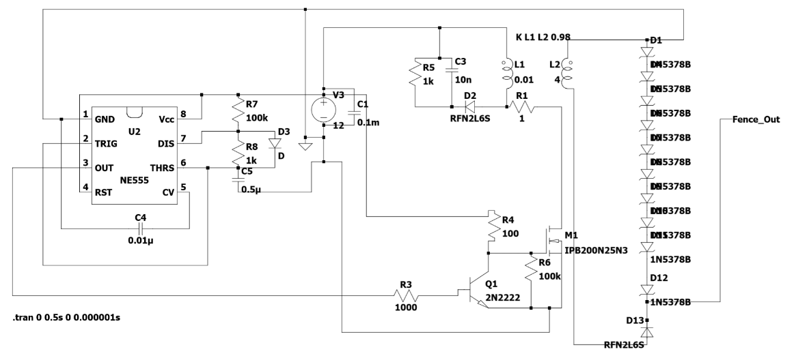
CIRCUIT SETUP

Slide 5
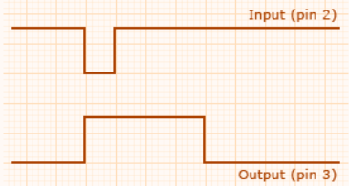
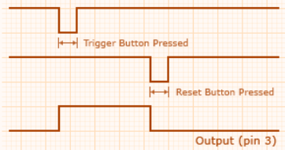
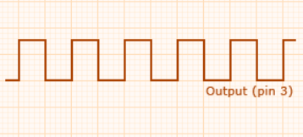
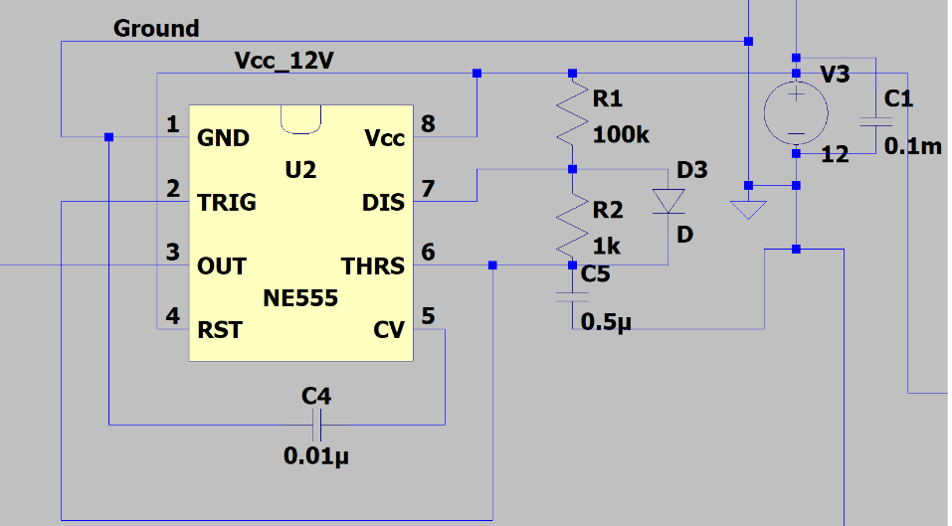
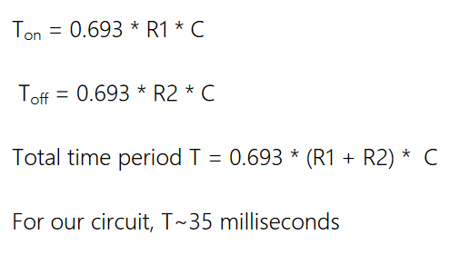
NE555 Timer Stage
Monostable Mode
Bistable Mode
Astable Vibrator

Slide 6
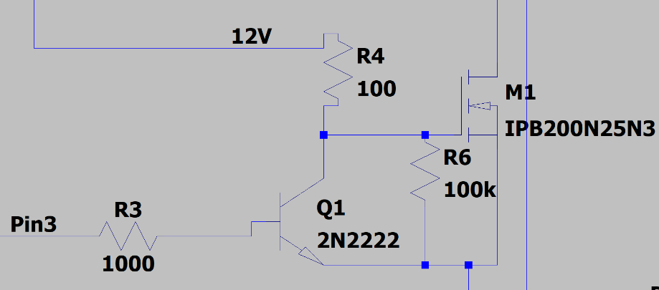
NPN & MOSFET Stage
Q1 is an NPN transistor, which receives its input from the output of the 555 timer(11mA) and amplifies it(120mA) so that it is able to drive the MOSFET properly. When 555 output is high(Pin 3), the current from collector of NPN passes to the ground, whereas when 555 output is low, this current passes to the Gate of the MOSFET, which is used to switch it. The signal is inverted due to this stage.
We have used an N channel MOSFET, which is a 3-terminal device, where the voltage at the Gate determines the conductivity of the device. This ability of the MOSFET to change conductivity by applying voltage at the gate can be used for amplifying or switching electrical signals. If the voltage across the Gate and Source is higher than the Threshold Voltage of that particular MOSFET, the current can flow through its Drain to its Source with a resistance of Rds(characteristic of each MOSFET).

Slide 7
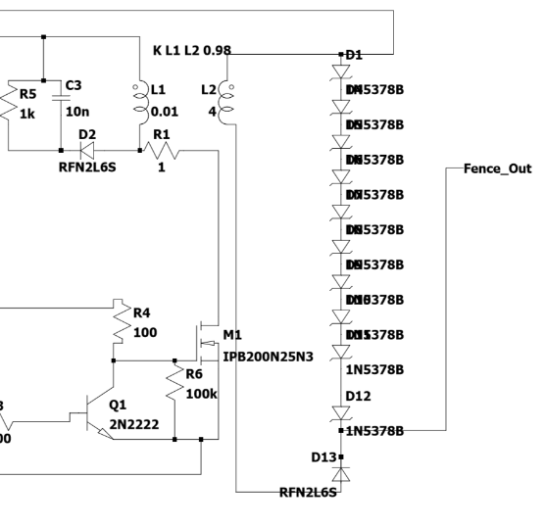

Secondary Side of Transformer
For transformers, 2 inductors are linked with each other(coupling factor=0.98), the turns ratio required is 5:100 for appropriate value of voltage at the secondary side. To properly regulate this 1000V value, Zener diodes are used, but since a breakdown voltage that large wasn’t available, we had to make do with 10 diodes with breakdown voltage equal to 100V, hence regulating the secondary side voltage to 1000v. Also a diode is placed in the opposite direction, to prevent the flow of current in the opposite direction. Each such Zener diode costs 20 rupees so we can also go for Zener diodes with lesser voltage rating to reduce the cost.
We take Lp = 0.01H, hence Ls =4H.

Slide 8
OVERALL DESIGN
The flow of current in the main circuit is controlled by the state of the MOSFET. When the MOSFET switch is closed, current flows from the orange dot to the green dot, passing through inductor and MOSFET and ultimately reaching ground. Whereas, when the MOSFET switch is open, this current flows from the orange dot, through the inductor, then proceeds towards the RC combination, via a diode(to prevent backflow of current into the inductor).
For switching the MOSFET, the output square wave of 555 Timer IC(red dot) is fed to the Base of the NPN Transistor, where it is amplified and inverted. This inverted square wave is sent as input to the Gate of the MOSFET. Hence when this input to MOSFET is low, it acts as an open circuit and does not allow current to pass, and when the gate current is not zero, it completes the path of the current, by allowing it to flow through it and ultimately reach ground.

Slide 9
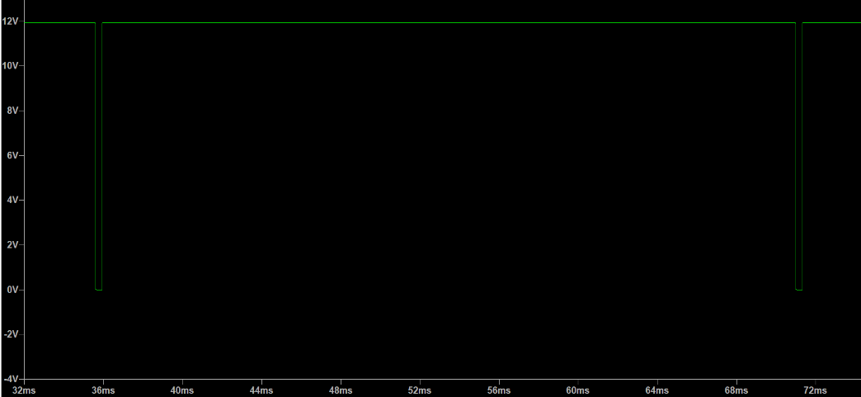
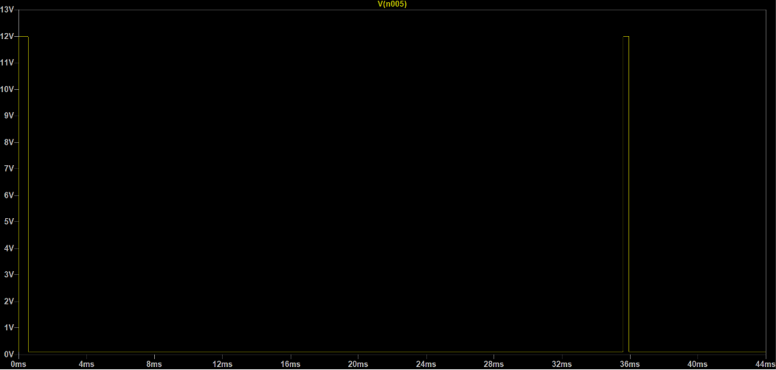
CURRENT AND VOLTAGE WAVEFORMS
Output of 555 Timer
Inverted and amplified input of MOSFET
(between Gate and Source)

Slide 10
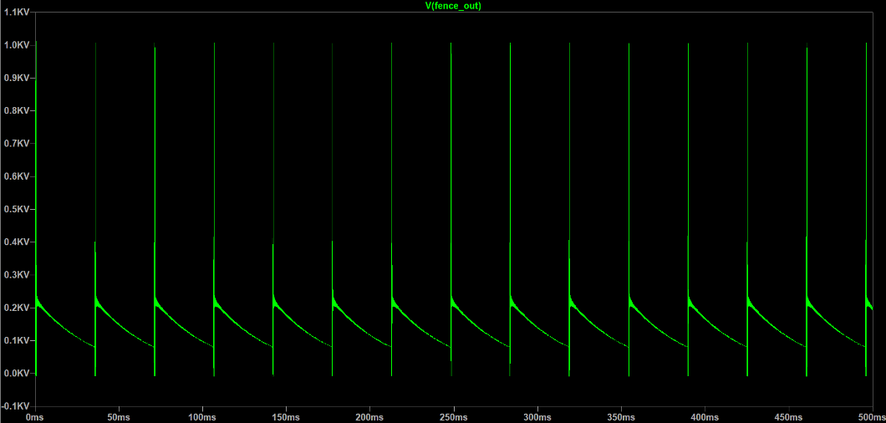
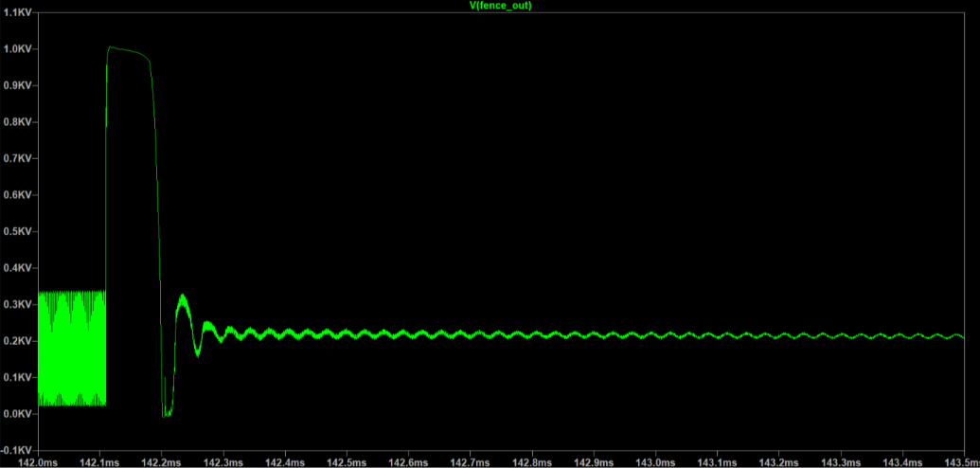
1000V pulses after every 35ms.
Zoomed in Output Pulse

Slide 11
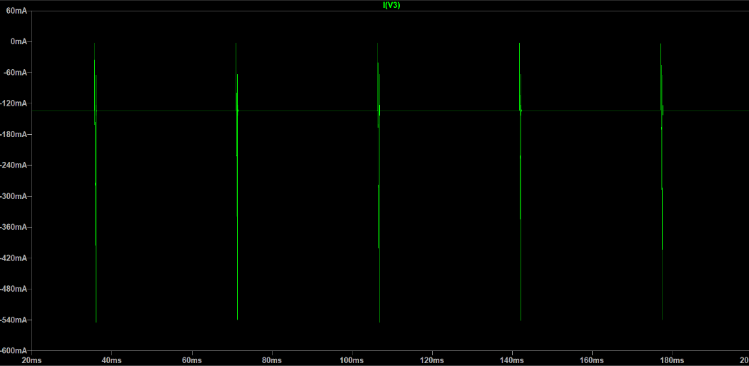
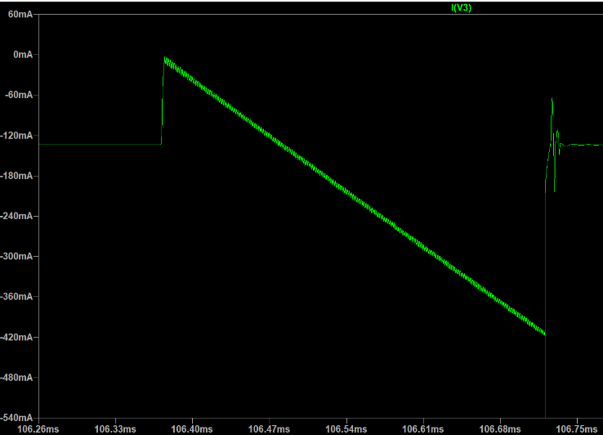
This is the current reading from the 12V Battery. Spikes of 0.4 Amperes are seen every few milliseconds, but the time-averaged current utilization is miniscule. Hence the overall power utilization is also very low, and this can be easily powered by the readily available 12V DC Battery. Since the 555 Timer output is high for 35ms, it takes 0.12A all the time, thus increasing the current consumption. Design changes can be made so that the duty cycle of this 555 Timer is similar to that of MOSFET, so that the time - averaged current consumption is even less.

Slide 12
ACKNOWLEDGEMENTS
I am extremely fortunate that I was assisted thoroughly by my mentors and seniors. All this was possible only because of the supervision and I can not forget to thank them.
Firstly, I would like to thank Dr. Rupamanjri Ghosh, Vice-Chancellor of Shiv Nadar University for providing me an opportunity to carry out this project.
I owe gratitude to my Faculty Mentor, Prof. Dinkar Prasad who suggested the problem statement, guided me and told me how to go about the problem in stages, till the very end of the project by providing me with all necessary information and solutions for my problems, all along. I sincerely thank him for devoting his precious time on this project.
I am extremely fortunate to get constant support and guidance from Teaching staffs of Electrical Department, teaching assistants and all the staff in the Laboratories at Shiv Nadar University for their timely support, for me to be able to complete this project.

Slide 13
REFERENCES
http://www.555-timer-circuits.com/operating-modes.html
https://www.analog.com/en/design-center/design-tools-and-calculators/ltspice-simulator.html
https://electrosome.com/astable-multivibrator-555-timer/
http://www.electricalbasicprojects.com/astable-multivibrator-multi-pulse-generator-circuit-design-using-555-timer-ic/
https://electronics.stackexchange.com/questions/96776/555-to-drive-a-mosfet
https://arduinodiy.wordpress.com/2012/05/02/using-mosfets-with-ttl-levels/
https://oscarliang.com/how-to-use-mosfet-beginner-tutorial/
https://www.electronics-tutorials.ws/transistor/tran_7.html
https://toshiba.semicon-storage.com/info/docget.jsp?did=59460
http://www.ti.com/lit/slua618
https://learnabout-electronics.org/PSU/psu32.php
https://components101.com/articles/boost-converter-basics-working-design
https://www.youtube.com/watch?v=kJDahaWfobw&list=WL&index=4&t=292s
https://www.youtube.com/watch?v=4xaPfY7r8qU&list=PLbfchYhJIkdNXl19jcUpwHhWxl_rsm_7U&index=6
https://www.youtube.com/watch?v=vezptJWVqtg&list=PLbfchYhJIkdNXl19jcUpwHhWxl_rsm_7U&index=7
https://www.youtube.com/watch?v=IbGrNgx6-lg&list=PLbfchYhJIkdNXl19jcUpwHhWxl_rsm_7U&index=1
https://www.youtube.com/watch?v=o4_NeqlJgOs&list=PLbfchYhJIkdNXl19jcUpwHhWxl_rsm_7U&index=2

